Slide 1

ABC Corporation GP 2015 Forecast
Christopher Heimbuch
As of May 01, 2025

Slide 2


Section l
Executive Summary

Slide 3

Executive Summary
As a reminder, the dataset consists of 6 different products with sales for 4 months of 2013 and full year 2014.
Key Findings:
Strong 2013 results as company started September 2013
~+3.9M in sales largely driven by Paseo product
Strong YoY performance:
Despite 4 month of sales in 2013, +236% increase in sales for FY2014 ACT
Strong outlook forward looking:
Expected ~7% increase in sales due to increase in demand (+5%) and reduced discount rates and small price increase (+2%)
Recommendations:
My recommendation focuses on sustaining growth through pricing and discount optimization, while mitigating COGS risks and improving data quality for better forecasting.

Slide 4

Section ll
Summary, Waterfall, & Forward Looking

Slide 5
Summary

Slide 6
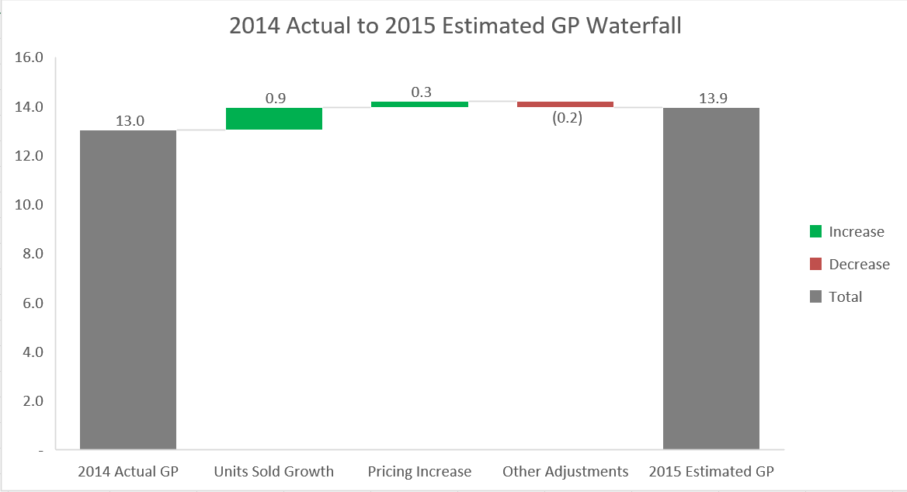
Waterfall

Slide 7

Forward Looking
We expect strong growth to continue going into 2015 due to product demand and working with customers to reduce discount rates.
Some things to be mindful of are tariff increases and macroeconomic policies (declining rates, increasing rates, no rate changes etc.)
Renegotiations/negotiations with shipping companies to get favorable freight rates
Work with suppliers on raw materials to get favorable deals or research new suppliers entirely

Slide 8

Section lll
Appendix

Slide 9
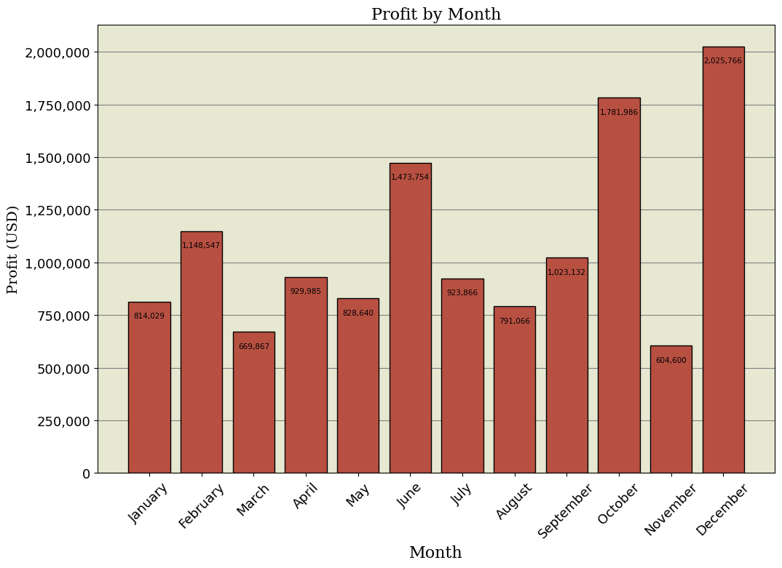

Slide 10
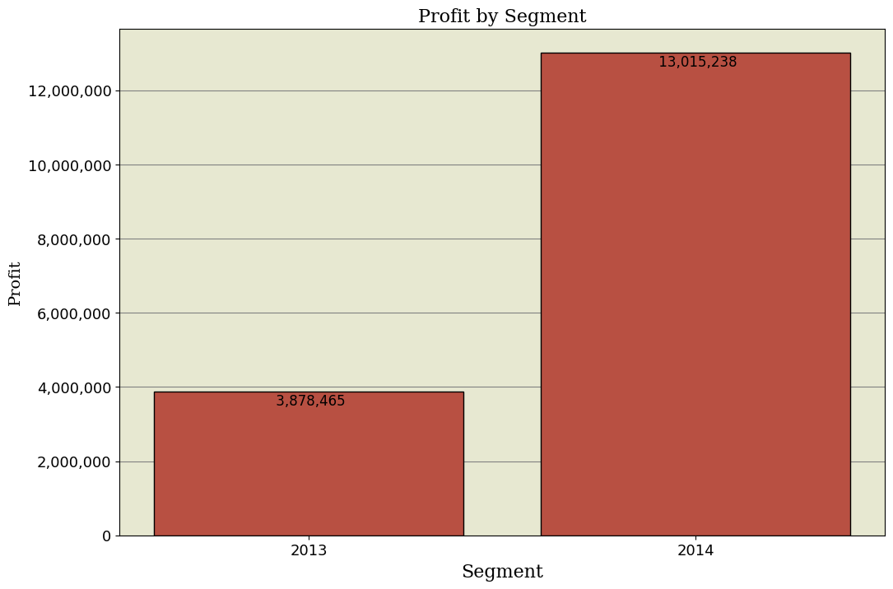

Slide 11
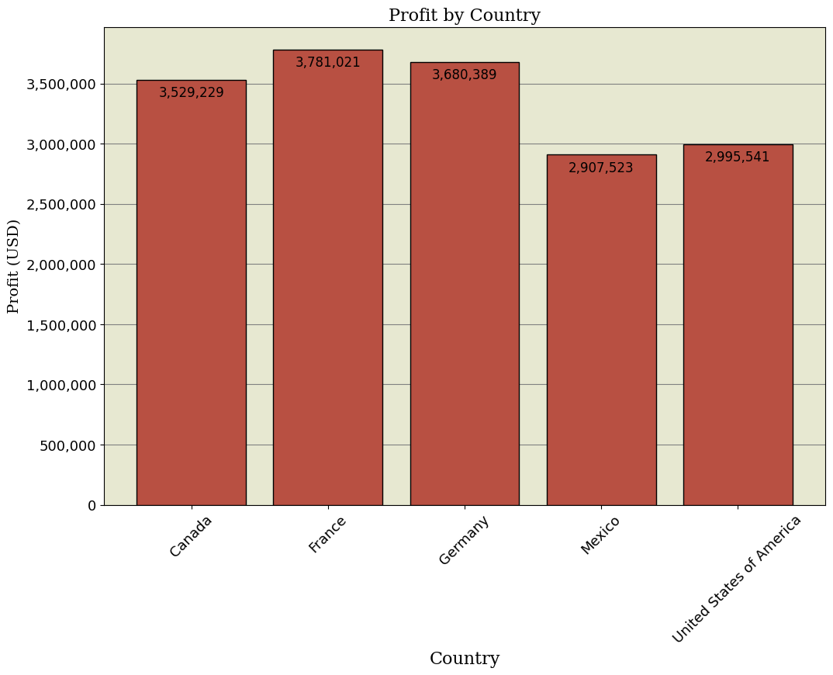

Slide 12
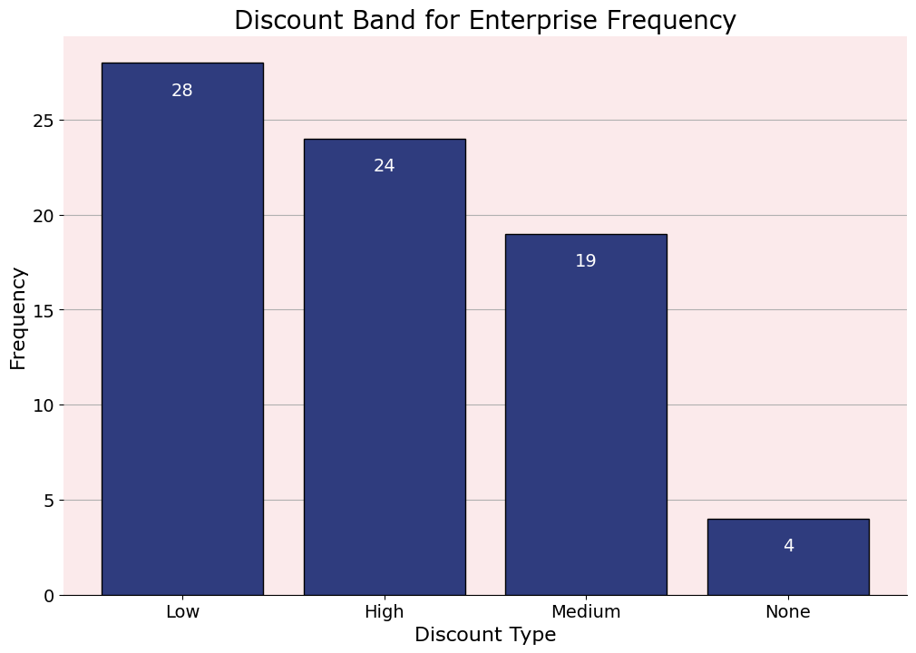

Slide 13
